Slide 1
Unit 10
May I
take a photo?
Lesson 3 - Song

Slide 2
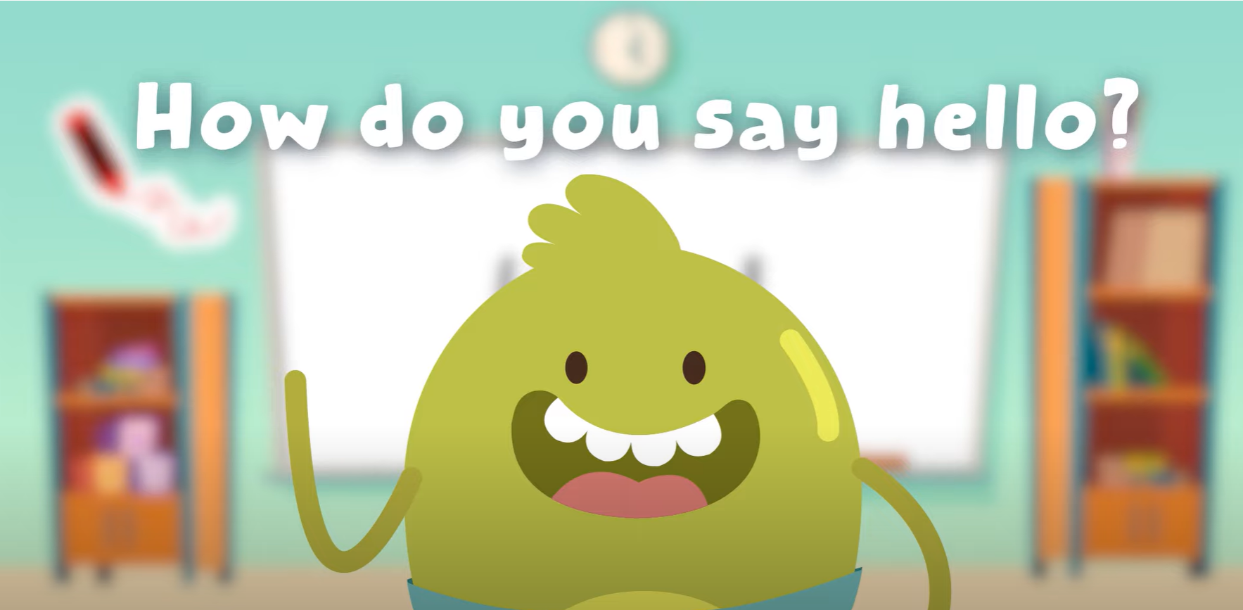
Hello song

Slide 3
Give me Five

Slide 4
Game
WHAT DO I HAVE?

Slide 5
WHAT DO I HAVE?
?
visit the gift shop
Notes:
Teacher uses pictures for this game.
Hide a picture behind teacher’s back. Ask students “What do I have?”
Invite one student to guess and say the phrase for each picture. Students have three guesses for each picture.

Slide 6
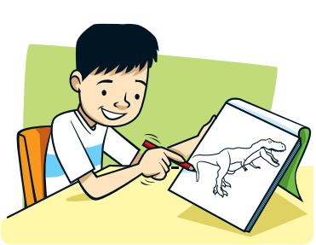
WHAT DO I HAVE?
?
draw a picture

Slide 7
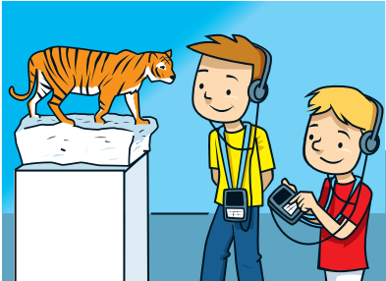
WHAT DO I HAVE?
?
listen to an audio guide

Slide 8
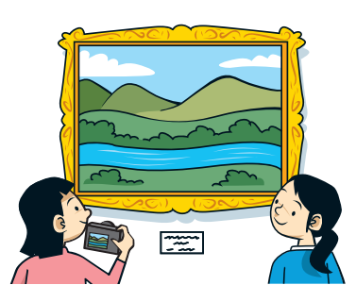
WHAT DO I HAVE?
?
take a photo

Slide 9
Good job!

Slide 10
Listen and REPEAT
Notes:
Listen and chant

Slide 11
Listen and REPEAT
Notes:
Listen and chant

Slide 12
Listen and REPEAT
Notes:
Listen and chant

Slide 13
Listen and point
Notes:
Listen and chant

Slide 14
Listen and Repeat
Notes:
Listen and chant

Slide 15
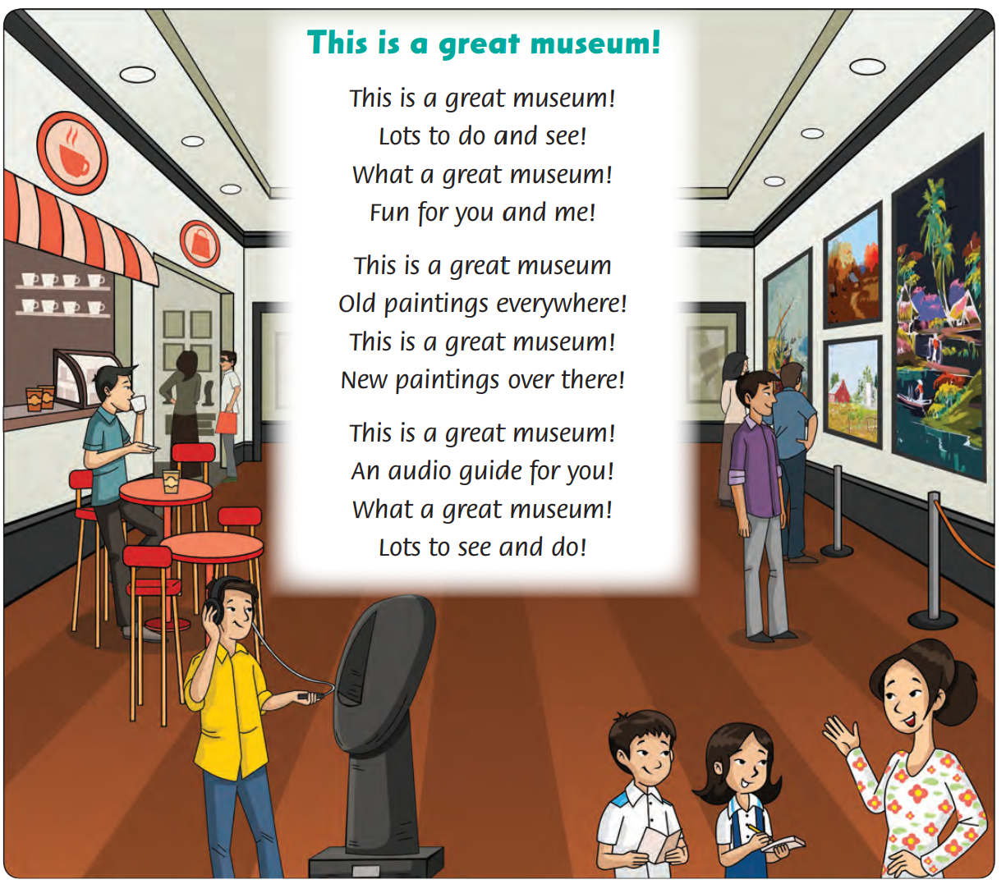
Look and Answer
78

Slide 16
Listen and Point
78

Slide 17
Listen and Repeat
78

Slide 18
Watch and Sing

Slide 19
Sing and Do
78

Slide 20
Watch and Sing.

Slide 21
Sing in Groups

Slide 22
Live on Stage

Slide 23
Good job!

Slide 24
Game
UNSCRAMBLE WORDS

Slide 25
UNSCRAMBLE WORDS
d
l
o
o
l
d
__ __ __

Slide 26
UNSCRAMBLE WORDS
e
n
w
n
e
w
__ __ __

Slide 27
UNSCRAMBLE WORDS
e
r
g
a
t
g
r
e
a
t
__ __ __ __ __

Slide 28
Good job!

Slide 29
Thank You

