Slide 1


Slide 2

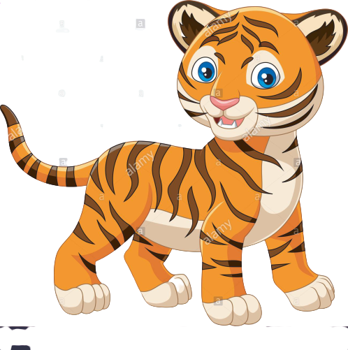

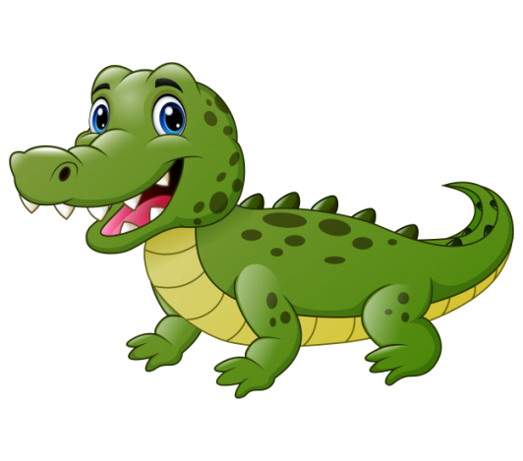
bear
Tiger
crocodile

Slide 3
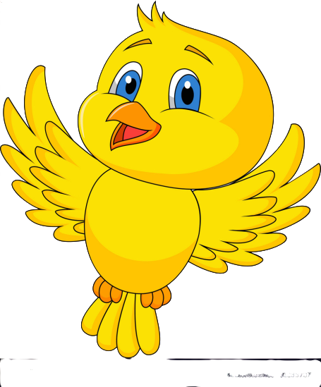
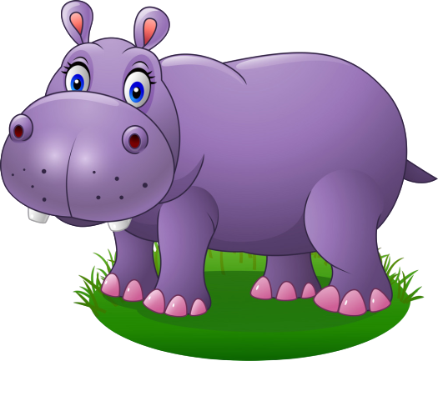
bird
hippo

Slide 4
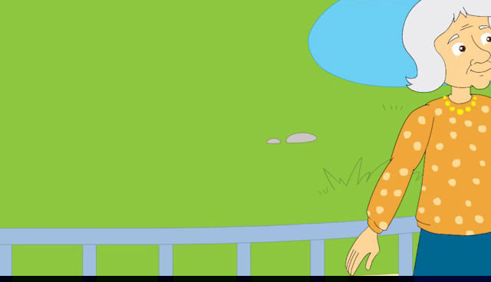
Video

Slide 5
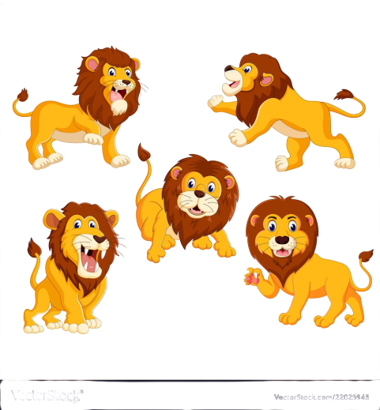

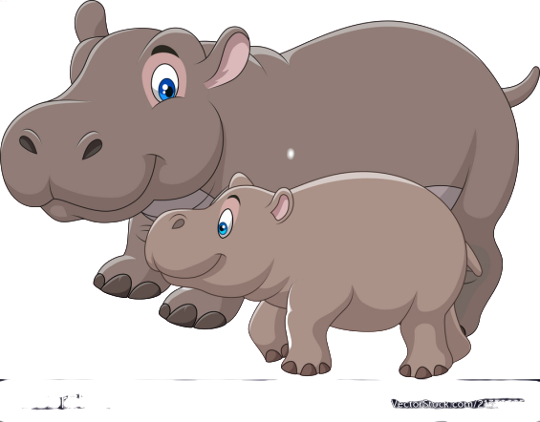
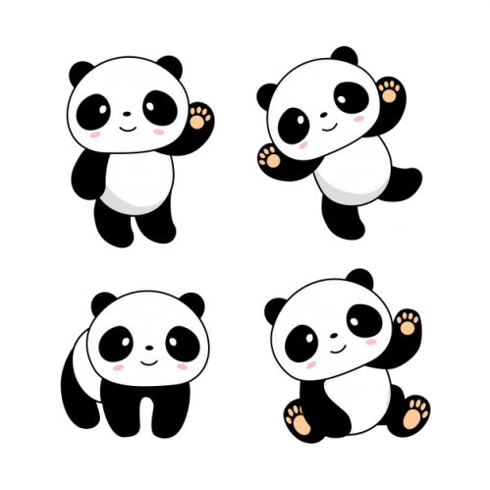
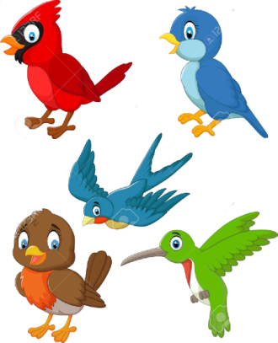
6.What are they?
They’re…
They’re bears
They’re lions
They’re hippos
They’re birds
They’re pandas

Slide 6
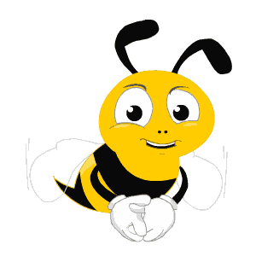


What are they?
They’re…
A. bears
B. lions
C. pandas
D. hippos

Slide 7
What are they?
They’re…
A. bears
B. lions
C. pandas
D. hippos

Slide 8
What are they?
They’re…
A. bears
B. lions
C. birds
D. pandas

Slide 9
What are they?
They’re…
A. bears
B. birds
C. lions
D. hippos

Slide 10


Slide 11


J j
Juice
Jug

Slide 12


Slide 13

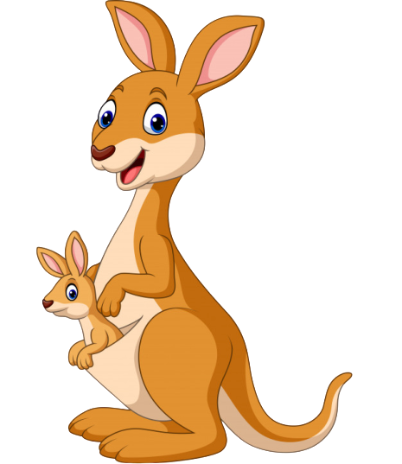
K k
Key
Kangaroo

Slide 14
e
e
K
?
?
y

Slide 15
a
i
K
?
g
a
r
o
o
?
n

Slide 16
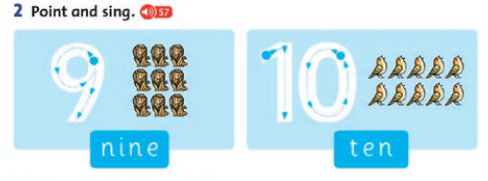

Slide 17

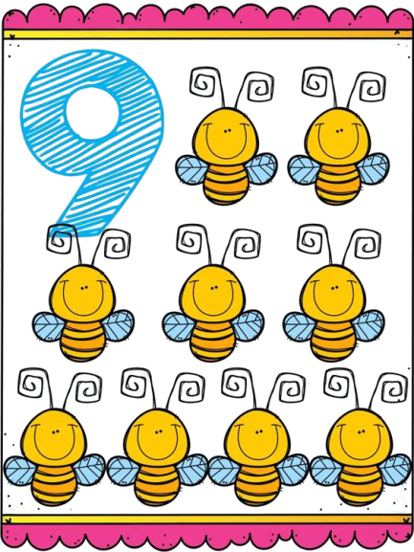
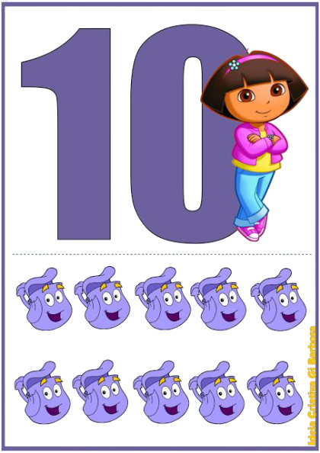
9, 10
Ten
Nine

Slide 18


Slide 19

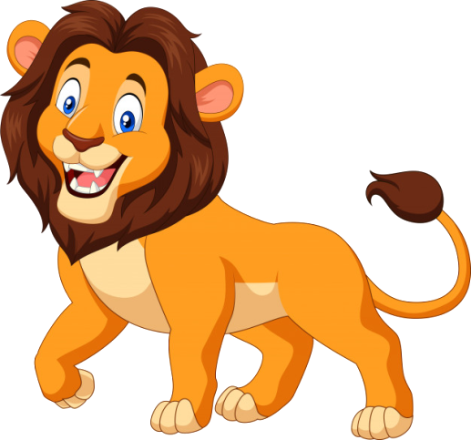
L l
Lion
Lollipop

Slide 20


Slide 21


M m
Man
Mango

