Slide 1


Grade 2
Unit 2
Lesson 1
He’s happy!

Slide 2
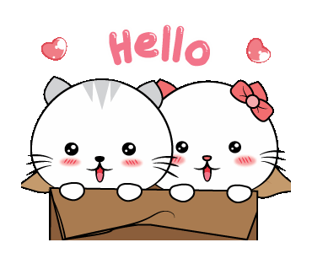

Slide 3


Slide 4

Game
Notes:
Use flashcards 9-14
Say a word
Reveal the cards one at time
When students see the card, they say: SNAP!

Slide 5

Listen and point

Slide 6


Slide 7

Listen and repeat

Slide 9

Work in groups

Slide 10
It’s play time!

Slide 11


SAD

Slide 12

HOT

Slide 13
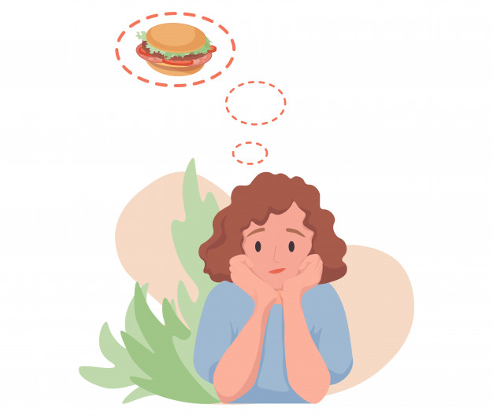
HUNGRY

Slide 14

THIRSTY

Slide 15

COLD

Slide 16

HAPPY

Slide 17
Listen and point

Slide 18


Slide 19

Listen and chant

Slide 22
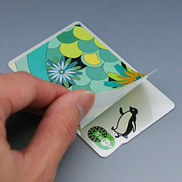
Let’s stick!

Slide 23
happy

Slide 24
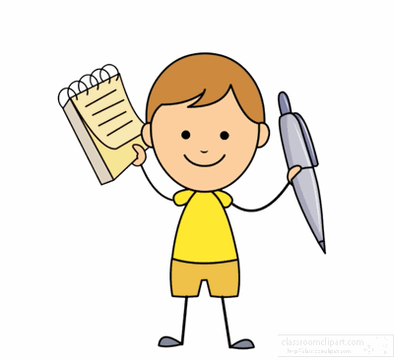
Workbook time!!!

Slide 25


Slide 26


