Slide 2
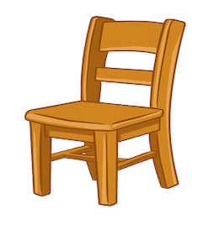
pencil
chair

Slide 3
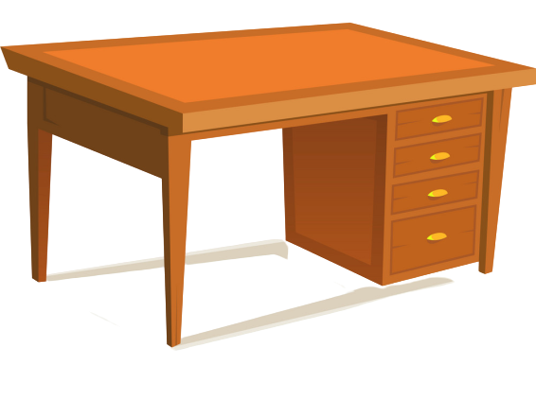
notebook
crayon
desk

Slide 4
Video

Slide 5
2. WHAT’S THIS? It’s a…
It’s a chair
It’s a crayon
It’s a desk
It’s a pencil
It’s a notebook

Slide 6
WHAT’S THIS? It’s a…
A. chair
B. table
C. crayon
D. pencil

Slide 7
WHAT’S THIS? It’s a…
A. chair
B. table
C. crayon
D. pencil

Slide 8
WHAT’S THIS? It’s a…
A. table
B. chair
C. crayon
D. pencil

Slide 9
WHAT’S THIS? It’s a…
A. chair
B. crayon
C. pencil
D. notebook

Slide 10
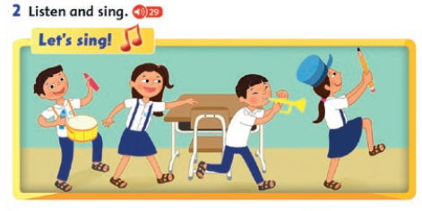

Slide 12
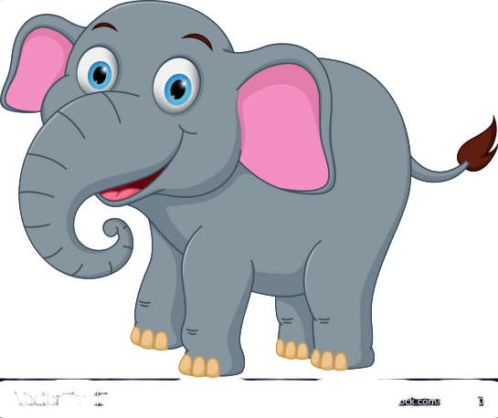
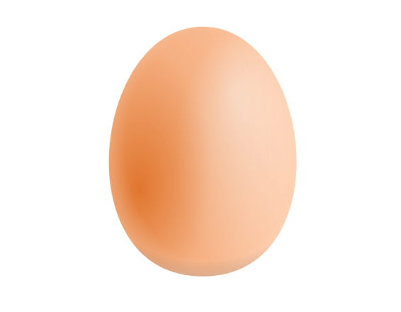
E e
Elephant
Egg

Slide 14
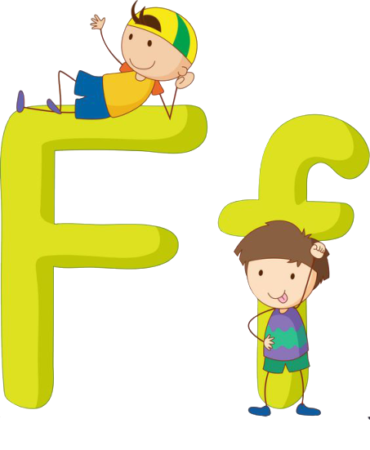
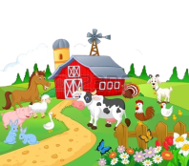
F f
Fish
Farm

Slide 15
e
i
F
?
i
s
h

Slide 16
g
i
E
?
g
g

Slide 17
e
l
E
?
?
e
p
h
a
n
t
Elephant

Slide 18
a
i
f
?
?
r
m

Slide 19
5,6
Five
Six

Slide 20
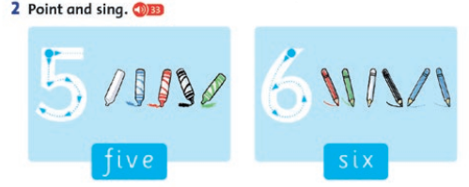

Slide 21
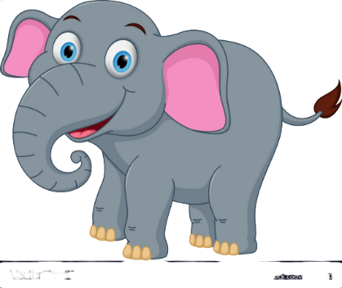
A. Four elephants.
B. Five elephants.
C. Six elephants.

Slide 22
A. Six fishes.
B. Five fishes.
C. Four fishes.

