Slide 2
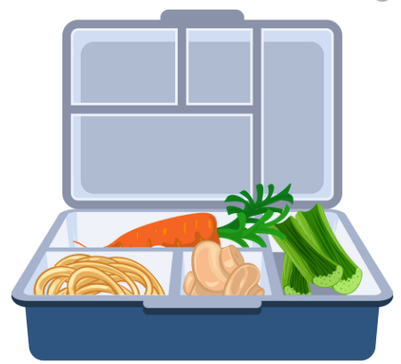
Lunch box
Biscuit
apple

Slide 3
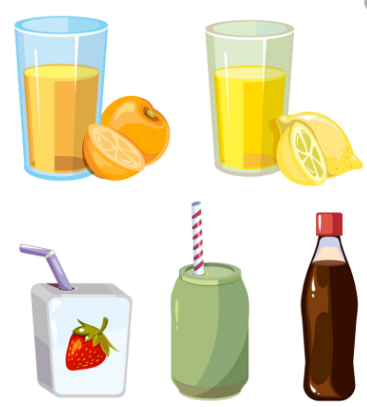
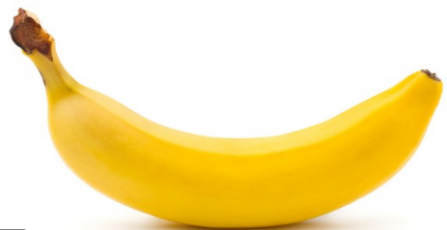
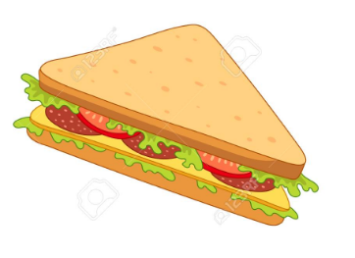
banana
Drink
sandwich

Slide 4
Video

Slide 5
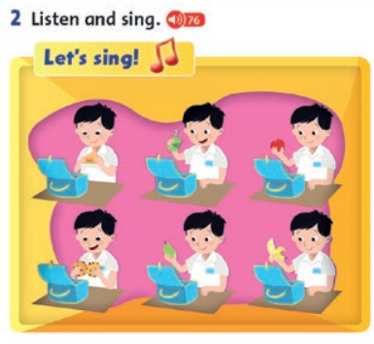

Slide 6
I’ve got….
A. A banana
B. An apple

Slide 7
I’ve got….
A. Two sandwiches
B. A sandwich

Slide 8
I’ve got….
A. An apple
B. A banana

Slide 9
I’ve got….
A. Five drinks
B. two drinks

Slide 10
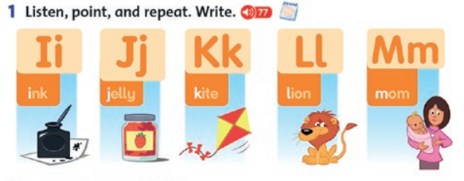

Slide 11
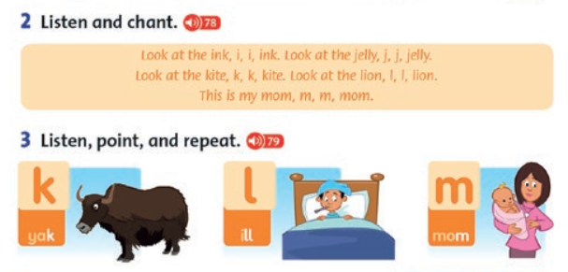

Slide 12
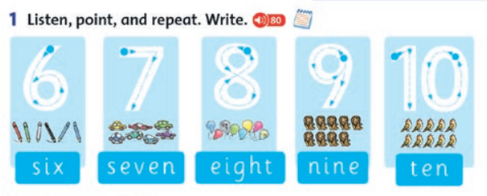

Slide 13
Match and say
A. six
B. seven
C. eight
D. nine

Slide 14
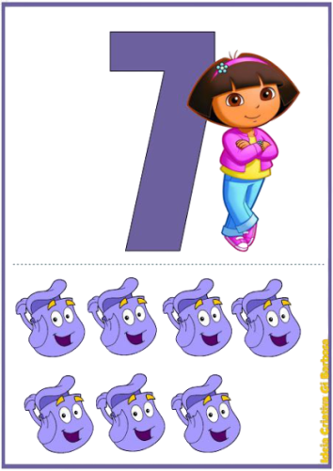
Match and say
A. eight
B. seven
C. six
D. five

Slide 15
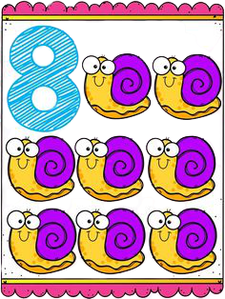
Match and say
A. five
B. six
C. seven
D. eight

Slide 16
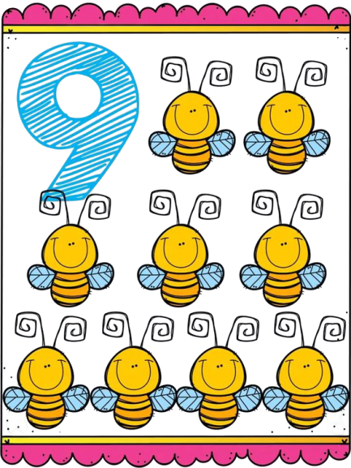
Match and say
A. seven
B. eight
C. nine
D. ten

Slide 17
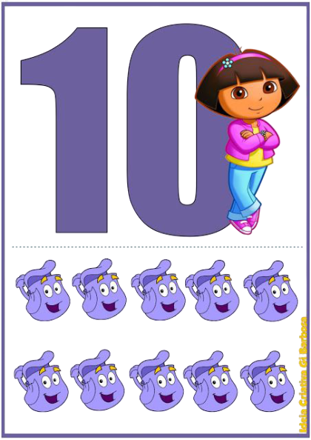
Match and say
A. ten
B. nine
C. eight
D. seven

Slide 19
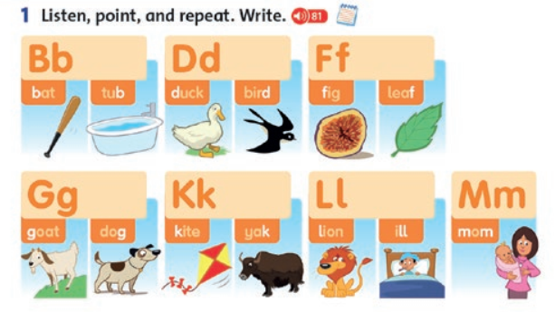

Slide 20
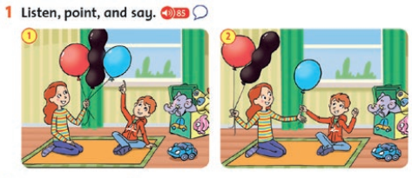

Slide 21
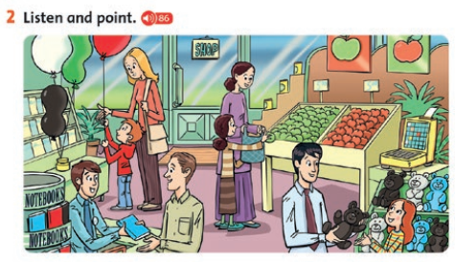

Slide 23
square
Circle
triangle

Slide 24
rectangle
diamond

Slide 25
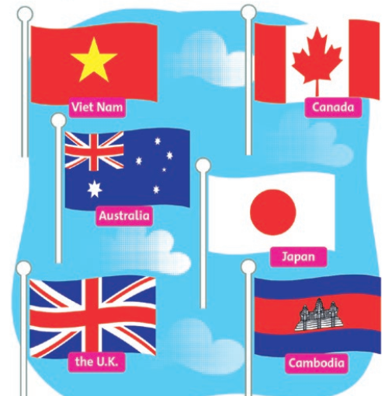

Slide 26
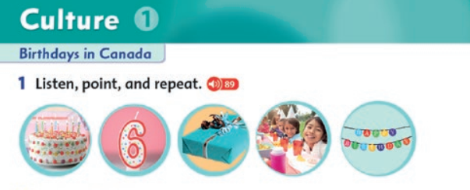

Slide 28
THANKYOU

