Slide 2
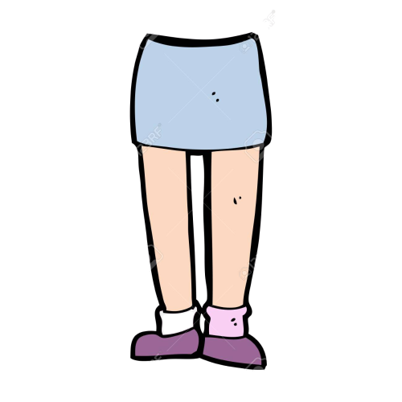
Arms
Nose
Legs

Slide 3
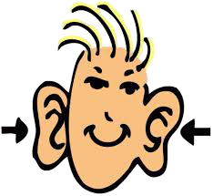
Face
Ears

Slide 4
Video

Slide 5
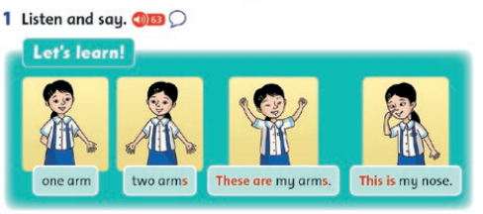

Slide 6
These are my…
A. legs
B. arms

Slide 7
These are my…
A. legs
B. nose

Slide 8
These are my…
A. ears
B. arms

Slide 9
This is my…
A. arm
B. nose

Slide 10
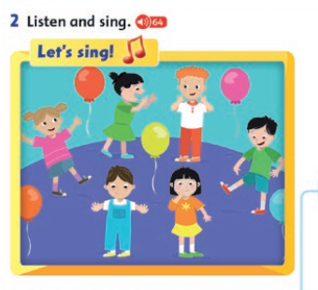

Slide 11
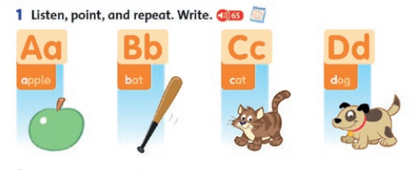

Slide 13
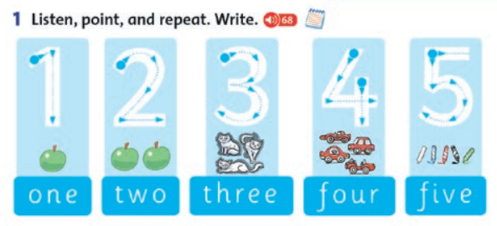

Slide 14
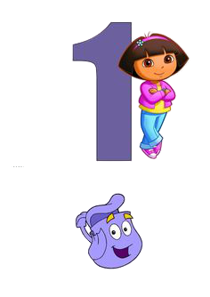
Match and say
A. one
B. two
C. three
D. four

Slide 15
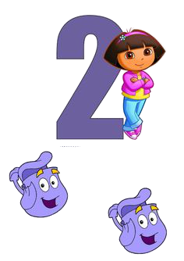
Match and say
A. one
B. two
C. three
D. four

Slide 16
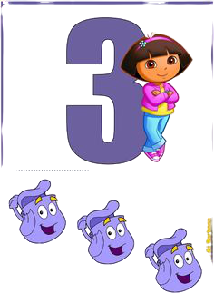
Match and say
A. one
B. two
C. three
D. four

Slide 17
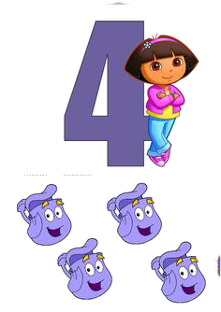
Match and say
A. one
B. two
C. three
D. four

Slide 18
Match and say
A. five
B. four
C. two
D. one

Slide 19
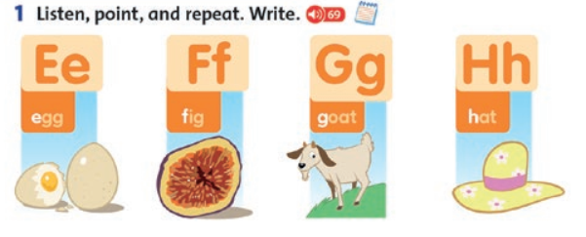

Slide 20
