Slide 2
What color is it?
Red
black
blue
white
green

Slide 3
video

Slide 4
1.What color is it? It’s..
It’s blue
It’s orange
It’s black
It’s green
It’s red
It’s white

Slide 5
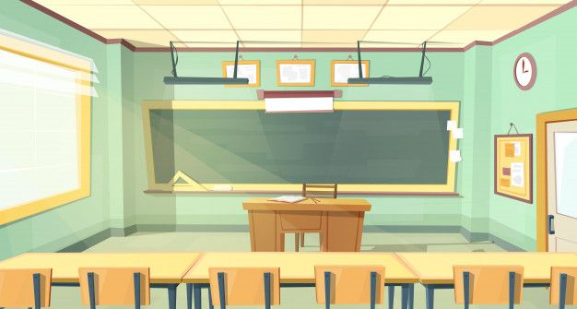
What color is this?
A. Blue.
B. Green.
C. Yellow.
It’s…

Slide 6
What color is this?
A. red.
B. blue.
C. orange.
It’s…

Slide 7
What color is this?
A. blue.
B. black.
C. red.
It’s…

Slide 8
What color is this?
A. black.
B. green.
C. blue.
It’s…

Slide 9
What color is this?
A. red.
B. green.
C. yellow.
It’s…

Slide 10
What color is this?
A. red.
B. black.
C. white.
It’s…

Slide 11
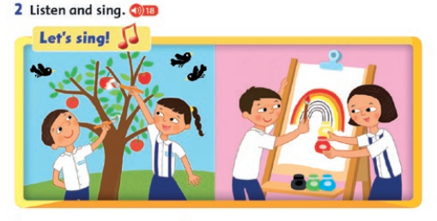

Slide 13
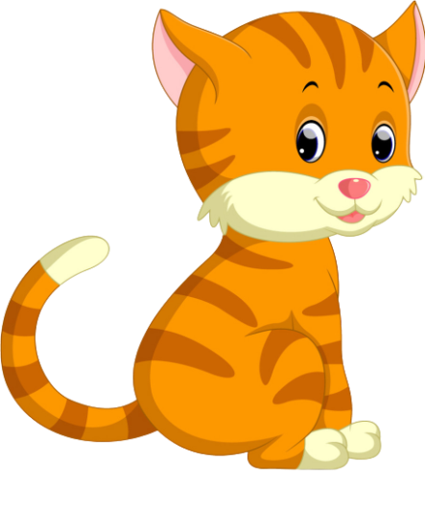
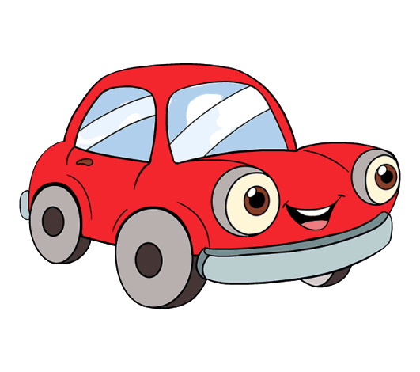
C c
Cat
Car

Slide 14
b
c
?
?
a
t

Slide 15
c
b
?
?
a
r

Slide 16
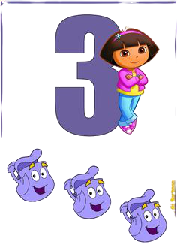
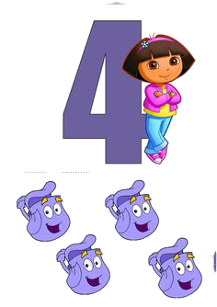
NUMBER 3,4
Three
Four

Slide 18
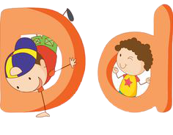
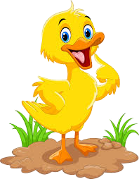
D d
Dog
Duck

Slide 19
t
d
?
k
?
u
c

Slide 20
d
b
?
?
o
g

Slide 21
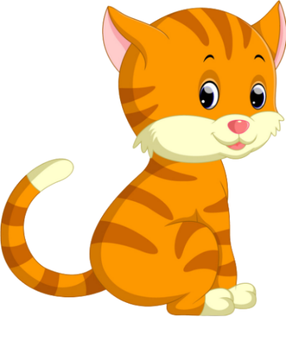
A. One cat.
B. Three cats.
C. Four cats.

Slide 22
A. Three dogs.
B. Four dogs.
C. Two dogs.

Slide 23
A. Three ducks.
B. Two duck
C. Four ducks.

