Slide 2
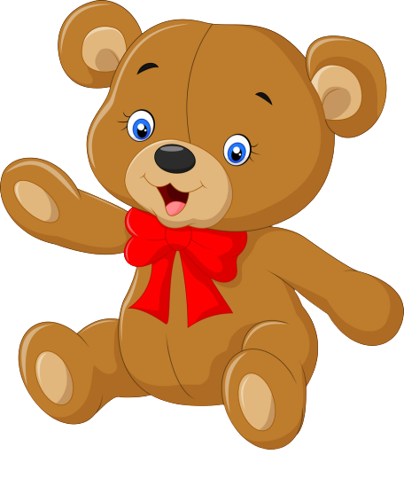
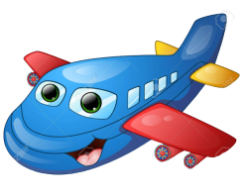
Teddy bear
Robot
Plane

Slide 3
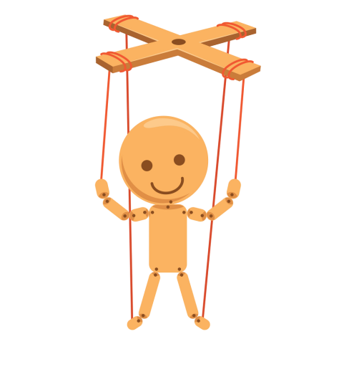
Puppet
Balloon

Slide 4
Video

Slide 5
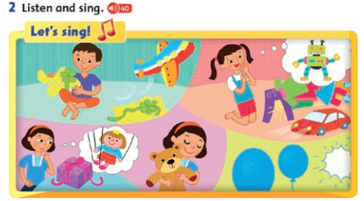

Slide 6
3. Is it a…? Yes, it is/No, it isn’t
Is it a puppet
Is it a plane?
No, it isn’t.
Yes, it is
Is it a puppet
Yes, it is

Slide 7
Is it a…? Yes, it is/No, it isn’t
Is it a balloon?
Is it a robot?
No, it isn’t.
Yes, it is
Is it a teddy?
Yes, it is

Slide 8
Is it a plane?
Yes, it is
B. No, it isn’t

Slide 9
Is it a …?
Yes, it is.
A. Teddy
B. robot

Slide 10
Is it a …?
Yes, it is.
A. robot
B. teddy

Slide 11
Is it a …?
Yes, it is.
B. puppet
A. Teddy

Slide 12
Is it a …?
Yes, it is.
A. robot
B. ballon

Slide 14
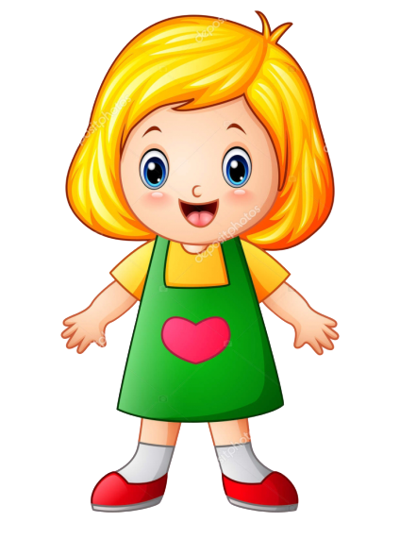
Gg
Girl
Guitar

Slide 15
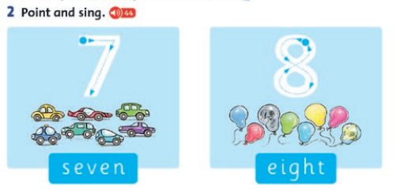

Slide 16
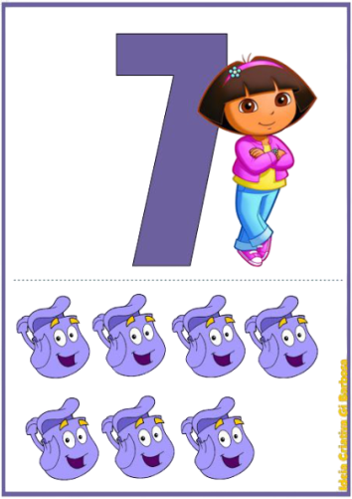
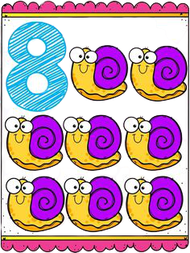
7, 8
Eight
Seven

Slide 17
A. Four planes.
B. Five planes.
C. Seven planes.

Slide 18
A. Six hats.
B. Eight hats.
C. Four hats.

Slide 19
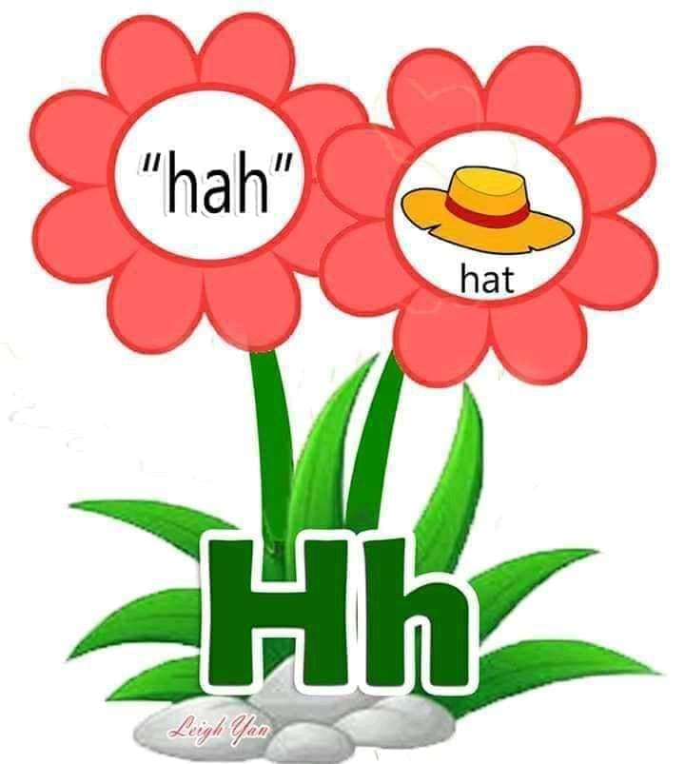

Slide 20
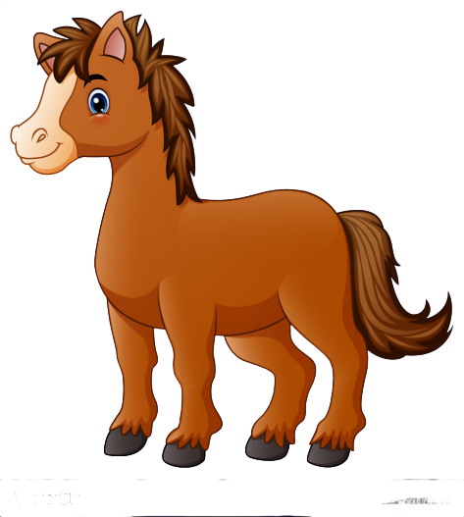
Hh
Hat
horse

Slide 22
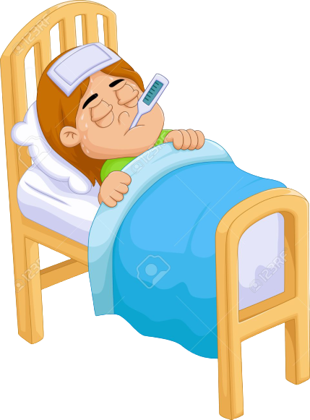
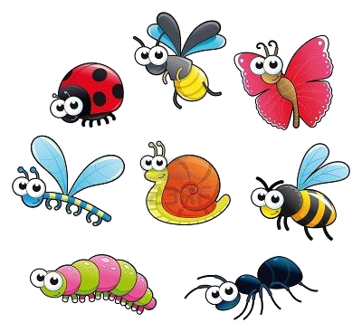
I i
insect
ill

